Slide 3
About Hardy Fruit Trees
Located in Sainte-Julienne, Quebec
Small nursery
Uncertified organic practice
Also sells other varieties of fruit and forest trees

Slide 4
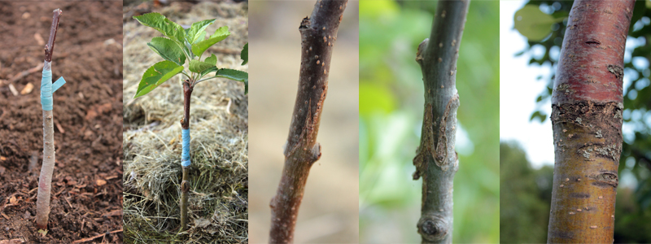
Why this nursery has more to offer
All of their 200+ varieties’ are grafted onto rootstock that can withstand temperatures as low as -45 degrees Celsius
A grafted tree will only take 3-5 years to produce fruit, non-grafted trees take 10 years
Knife Grafting
Multiple Graft Examples

Slide 5
Grafting onto the proper rootstock can minimize diseases
They are unlike apple trees usually found in garden centers
Garden center trees are over weight, their root systems are too small for their trunk and branches
Therefore experience a larger shock when transplanted
Trees from this nursery are squat, and have large root systems that can support its small trunk and branches through transplanting

Slide 6
Fodder, fuel, timber, or as a food source***

Slide 7
Benefits to Nepal
Source of Food
nutrition
Large root system to prevent erosion
A reasonable investment for a family farm that will continue to give back
Has ability to adapt to a wide range of the hilly region’s altitudes

Slide 8
Benefits to Nepal
Soil must stay fertile and well drained for it to produce fruit in the first 3-5 years
This is a problem for some locations in the hilly region because of their varying irrigation, and Nepal's common problem of keeping nutrients in their soil.

Slide 9
Benefits to Canada
Minimal start up cost
All farm work is done by hand and without fertilizers, therefore minimizing fuel emissions and remaining environmentally friendly
If the project expands, it will provide Canadians with honest work, working with their hands
This could be made into a program all its own to teach people good values
Reforestation for our own country
Risk of wide spread disease because of grafting – multiple apple species required

Slide 11
Brianne Gragtmans, Hardy Apple Trees in Nepal
University of Guelph in partnership with IDRC CIFSRF and DFAIT
Faculty Sponsor: Prof. Manish Raizada (raizada@uoguelph.ca)
Total presentation time: 5min 12sec
Special thanks to Sydney for filming!
Further information: www.hardyfruittrees.ca

